Slide 1

Civitas Accessing The Power of cities
Notes:
Hello, My name is Christian Conroy and I am the founder of Civitas.
While cities generate close to 85% of global GDP, there is no data source that exists that quantifies city metric and policies across the global across time. While large cities like Toronto, San Francisco, and New York have established robust data collection and analysis capabilities, most cities do not have the manpower or budget necessary to collect or analyze data, let alone prepare it in a standardized way that can be benchmarked against other cities.

Slide 2
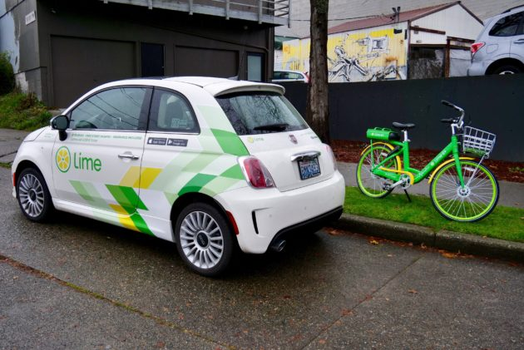


Problem: The Data Does Not Exist
Companies
City Government
Academia
Notes:
Let’s say you are the CEO of a shared mobility company like Bird or Skip and you are considering which urban market is best to launch your next fleet of electric scooters. What data source can you turn to analyze profitability, scale, and regulatory hurdles?
How about if you are the Director of the Department of Transportation in Washington DC and you need to evaluate how shared bike and scooter services could reduce congestion in the District? Where can you look to see how such programs have causally impacted traffic congestion in other cities around the world?
What if you are a Public Policy researcher at Georgia State University and you want to know how proximity to public bus stops influences poverty rates? Where can you find a large sample size of cities to analyze the correlations or causal impacts?
Supplementary Questions
Does implementing congestion pricing incentivize people to move away from cars and towards transportation options like walking or biking that are much better for the environment?
Does easing up zoning laws and increasing the density of commercial offices and apartments lead to increased foreign direct investment and business activity?
Does investing in government provided entrepreneurial training programs increase organic growth and startup survivability?

Slide 3
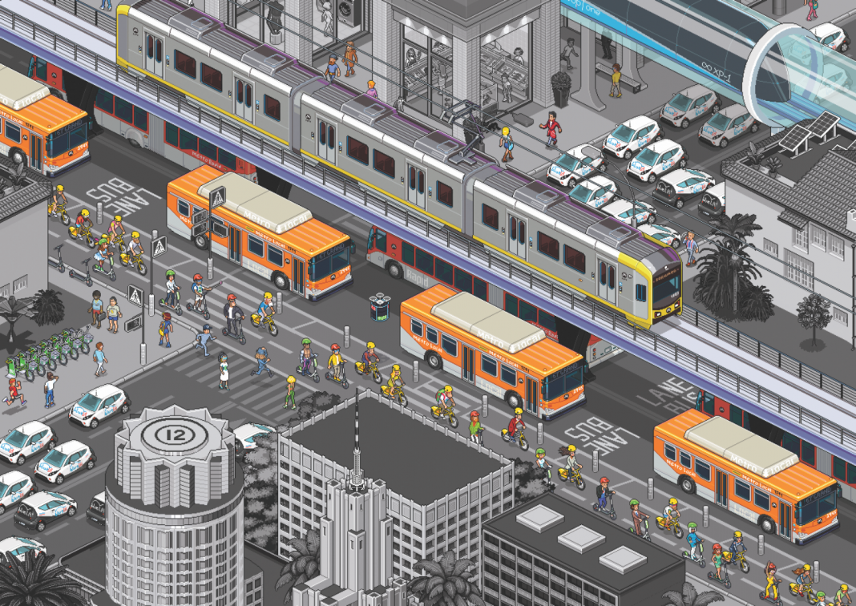



Using Data for Urban Transportation and Mobility
Companies
Identify best market to launch next fleet of shared cars, bikes, or scooters
City Government
Evaluate impact of shared bike systems on reducing emissions
Academia
Study correlations between public transportation proximity and poverty rates
Notes:
Let’s say you are the CEO of a shared mobility company like Bird or Skip and you are considering which urban market is best to launch your next fleet of electric scooters. What data source can you turn to analyze profitability, scale, and regulatory hurdles?
How about if you are the Director of the Department of Transportation in Washington DC and you need to evaluate how shared bike and scooter services could reduce congestion in the District? Where can you look to see how such programs have causally impacted traffic congestion in other cities around the world?
What if you are a Public Policy researcher at Georgia State University and you want to know how proximity to public bus stops influences poverty rates? Where can you find a large sample size of cities to analyze the correlations or causal impacts?
Supplementary Questions
Does implementing congestion pricing incentivize people to move away from cars and towards transportation options like walking or biking that are much better for the environment?
Does easing up zoning laws and increasing the density of commercial offices and apartments lead to increased foreign direct investment and business activity?
Does investing in government provided entrepreneurial training programs increase organic growth and startup survivability?

Slide 4
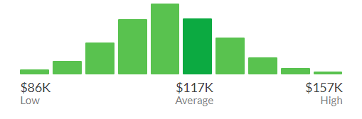
Problem: Cities Struggle to Collect and Use Data
Avg. local gov. payout for similar title: $78,000
Avg. Base Pay for Data Scientists in the US: $117,345
Notes:
Let’s say you are the CEO of a shared mobility company like Bird or Skip and you are considering which urban market is best to launch your next fleet of electric scooters. What data source can you turn to analyze profitability, scale, and regulatory hurdles?
How about if you are the Director of the Department of Transportation in Washington DC and you need to evaluate how shared bike and scooter services could reduce congestion in the District? Where can you look to see how such programs have causally impacted traffic congestion in other cities around the world?
What if you are a Public Policy researcher at Georgia State University and you want to know how proximity to public bus stops influences poverty rates? Where can you find a large sample size of cities to analyze the correlations or causal impacts?
Supplementary Questions
Does implementing congestion pricing incentivize people to move away from cars and towards transportation options like walking or biking that are much better for the environment?
Does easing up zoning laws and increasing the density of commercial offices and apartments lead to increased foreign direct investment and business activity?
Does investing in government provided entrepreneurial training programs increase organic growth and startup survivability?

Slide 5
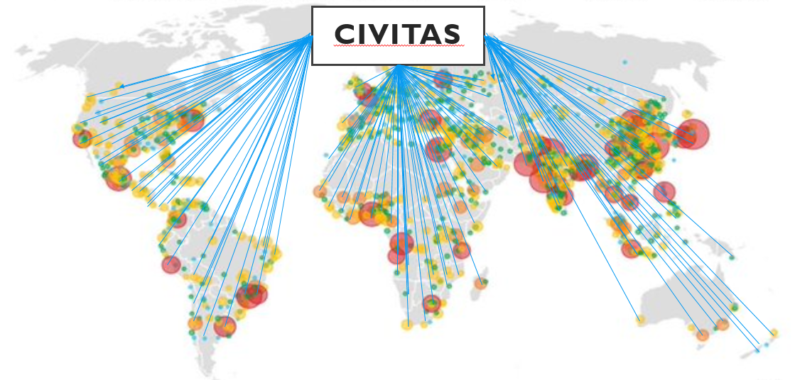
Solution: We’ll Make the Data Exist
Notes:
My venture will help answer these questions by collecting information on hundreds of different indicators for cities over time.

Slide 6

Business Model – Subscription Pricing
 | Basic Plan | Business Plan | Premium Plan | Enterprise Plan
Public Indicator Data Collected on Cities at National/Federal Levels – Raw Data Access
Public Indicator Data Collected on Cities at National/Federal Levels – Portal Access
Basic Analytics and Data Visualizations
Indicator Data for Cities – Continuous Variables
Indicator Data for Cities – Policy Variables
Advanced Analytics and Data Visualizations
Platform Customization and Technology Integration
Consulting Services and Strategic Development
Notes:
The primary revenue generation for the product will come from the companies and investment firms that pay into various tiers of the subscription model in the same way that they currently do for products like Bloomberg Terminals. The tiered subscription model will take advantage of a value-based pricing model where large companies and investment firms basing significant investment decisions off of data access will pay higher prices compared to local governments, research institutions, or media outlets that would pay little or nothing at all for access.
Subscriptions will be priced based on what type of data is being accessed, the associated data visualizations and analytics built on top of the data, customization and platform integration, and consulting and strategic advisory services offered.
The secondary revenue generation for the product will come from the local governments that pay for Civitas to efficiently guide the data collection, processing, and analysis process at a cost far less than that needed to hire full time data scientists or engineers. The added benefit of this dual revenue structure is that it established a positive feedback loop whereby Civitas is contracted to provide data collection and analysis services and then the data is subsequently layered into the urban data platform offering that serves as the primary revenue driver.

Slide 7






Pricing and Revenue Generation
Companies and Investors
Top-line price starts at $10,000 for annual subscription
Academic Institutions
Local Governments
$2,000 Base Price
Variable based on number of users and Carenegie classification
Access to data will be free or at a low price for most governments
Data processing and analysis contracts range $150,000-$200,000
$1,200
$5,700
$12,000
$13,000
$22,000
$25,000
$10,000
Civitas
Notes:
We looked at 41 different actors in the DC innovation ecosystem
We conducted 11 total interviews with urban farmers, incubators, boot camps, entrepreneurial community members, and other actors
This is of course on top of the global research which spanned close to 100 actors across multiple continents
Cities: 6 from the project + Barcelona, NY, Boston, Sweden
Number of startups ( Global startup research folder - 80 in there)
WHAT GOING TO DO
Different indicators
Urban impact for various tech spaces - incubators/accelerators - what data to look out
Policy
Services: partnerships - vcs
Specifically launched here in DC- what was adopted → examples of multipliers

Slide 8







Competitive Landscape
 | Issue Coverage | Geo Coverage | Time Coverage | Real vs. Forecast | Comparison Tool Focus | Free Licensing
Notes:
The primary revenue generation for the product will come from the companies and investment firms that pay into various tiers of the subscription model in the same way that they currently do for products like Bloomberg Terminals. The tiered subscription model will take advantage of a value-based pricing model where large companies and investment firms basing significant investment decisions off of data access will pay higher prices compared to local governments, research institutions, or media outlets that would pay little or nothing at all for access.
Subscriptions will be priced based on what type of data is being accessed, the associated data visualizations and analytics built on top of the data, customization and platform integration, and consulting and strategic advisory services offered.
The secondary revenue generation for the product will come from the local governments that pay for Civitas to efficiently guide the data collection, processing, and analysis process at a cost far less than that needed to hire full time data scientists or engineers. The added benefit of this dual revenue structure is that it established a positive feedback loop whereby Civitas is contracted to provide data collection and analysis services and then the data is subsequently layered into the urban data platform offering that serves as the primary revenue driver.

Slide 9
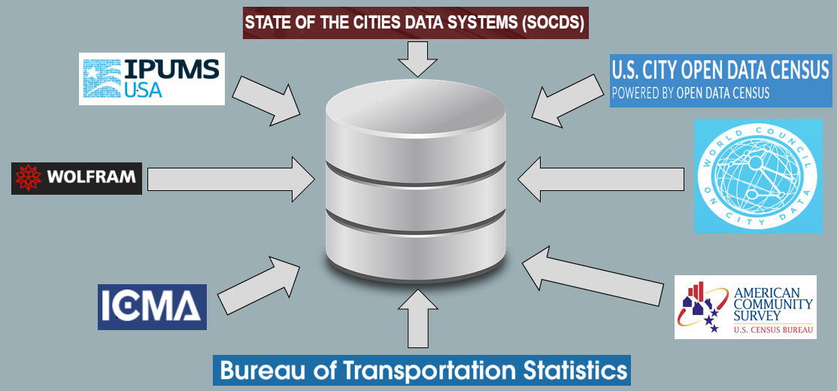
Building out the Base Level: Transportation & Mobility MVP

Slide 10

Moving Forward: Why Now?
Notes:
ISO 37120 - the first international standard on indicators for sustainable cities – was published in 2014
Establishes a set of standardized indicators that provide a uniform approach to what is measured in the context of city indicators, and how that measurement is to be undertaken
The ISO 37120 is formed of 17 themes dealing with city services and quality of life, ranging from Education to Water and Sanitation, which enable cities to measure progress on infrastructure projects over time, assess their performance, and draw lessons through comparison with other cities.
Cities are getting certified against it for better more standardized consistent data collection, reporting, and organizing
Without that standard the data normalization costs will be so substantial/a high hurdle to scale that investors will be concerned, but this decreases the costs over time

Slide 11
Civitas Accessing The Power of cities
Christian Conroy
CEO & Founder
cmc454@georgetown.edu
Notes:
For phase 3, it won’t necessarily just be governments: For example, companies like Populus working with lime, who is launching a car sharing service! (Limepod)
Value proposition is also in saving the governments time -> There is a huge amount of effort involved with cleaning, processing, and harmonizing the data
The cities don’t have the engineering and data science resources
They can do it more efficiently and at a lower cost (Ideally we’ll be doing this the whole time, but it’s more of phase 3)
For Phase 3: Five key steps that cities can replicate to develop their own analytics projects: (1) identify the problem; (2) assess data readiness; (3) scope the project; (4) pilot the project; and (5) implement and scale the model.
Example for energy as an issue area: For example, we have a company that focuses on automated washing machine services, and something that benchmarks energy indicators across urban environments might be useful
- Further examples of Use Cases
Investors
Think of how companies like Planet Labs that offer satellite photos on anything from how much parking spots are occupied at a retailer on any given day to where bottlenecks in the coal supply chain typically occur to land-related signs that a bad harvest is coming that will jack up crop prices in developing countries
City governments
Does easing up zoning laws and increasing the density of commercial offices and apartments lead to increased foreign direct investment and business activity?
Does investing in government provided entrepreneurial training programs increase organic growth and startup survivability?
Does affordable housing subsidization increase the amount of high-skilled young talent that moves to a city and can serve as a strong human capital pool?
Does increasing public greenspace increase livability and promote inclusive communities?
Does implementing congestion pricing incentivize people to move away from cars and towards transportation options like walking or biking that are much better for the environment?
Do subsidized urban farming programs increase public health outcomes and decrease local healthcare costs?
These are all questions that municipal governments want answers to but have no way of evaluating before spending money on such policy initiatives
Academic
When I began thinking about what I would write my thesis for the McCourt School of Public Policy at Georgetown, my original goal was to develop a model that would evaluate which city-level indicators were most useful in predicting foreign direct investment growth.
While such models have been developed to evaluate which macroeconomic indicators were most useful in predicting country-level GDP growth, no such study had been attempted using city-level data

